Slide 1
DIGITAL PORTFOLIO
STUDENT NAME:VIGNESH K
ROLL NO AND NMID:asanm1082413108180252108 DEPARTMENT: COMPUTER SCIENCE
COLLEGE/UNIVERSITY:TKGAC/ANNAMAKAI UNIVERSITY

Slide 2
PROJECT TITLE
TO CREATE A STUDENT PORTFOLIO

Slide 3
AGENDA
PROBLEM STATEMENT PROJECT OVERVIEW END USERS TOOLS AND TECNOLOGIES FEATURES AND FUNTIONALITY RESULTS AND SCREENSHOTS SCREENSHOT CONCLUSION

Slide 4
PROBLEM STATEMENT
IN THE DIGITAL ERA ,RESUMES AND CERTIFICATE ALONE ARE NOT ENOUGH FOR STUDENTS TO EXPRESS THEIR CREATIVITY AND SKILLS

Slide 5
PROJECT OVERVIEW
THE PROJECT FOCUSES ON DESINING AN INTERACTIVE STUDENTS
PORTFOLIO WEBSITE WHERE ACADAMIC RECORDS .THE AIMS IS TO
CREATE A PROFESSIONAL
YET PERSONAL ONLINE IDENTITY

Slide 6
END USERS
PEERS-TO GET INSPIRED AND LEARN FROM OTHER STUDENTS WORK
PARENTS-TO TRACK AND CELEBRATE THEIR CHILD PROGRESS

Slide 7
TOOLS AND TECNOLOGIES
HTML,CSS ,JAVASCRIPT,CANVA,GITHUB,LANDING PAGES,PROFILE
SECTION,TIMELINE.

Slide 8
RESULTS AND SCREENSHOTS
THE FINISHED PORTFOLIO PROVIDES A PROFESSIONAL YET ATTRACTIVE REPRESENTAION FO A STUDENT IDENTITY

Slide 9
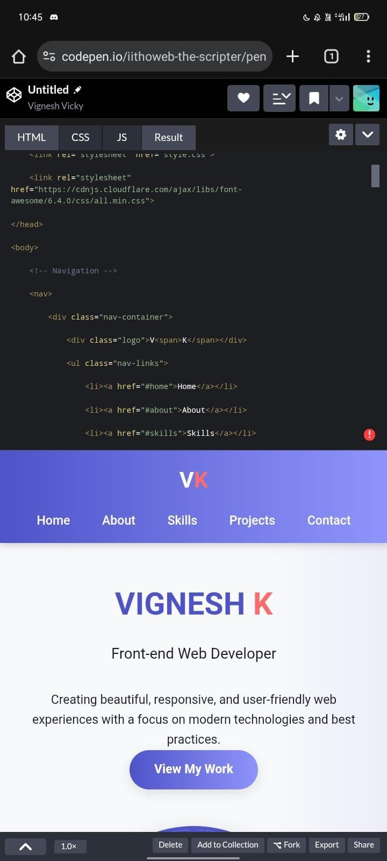
SCREENSHOT

Slide 10
CONCLUSION
THE PROJECT PROVES HOW A DIGITAL PORTFOLIO CAN SERVE AS A PERSONAL BRAND FOR STUDENTS .IT NOT ONLY HELPS IN ACADEMICS AND CAREER GROWTH BUT ALSO BIULS CONFISENCE BY PRESENTIND THE STRUCTURE.

